Slide 1

DNA STEGANOGRAPHY

Slide 2
201901044 Varun Motwani
Team Members
Heer Gohil
Mansi Madhvani Aakash Desai
201901135
201901194
201901223
201901452 Jheel Shah
201901468 Priyanshu

Slide 3
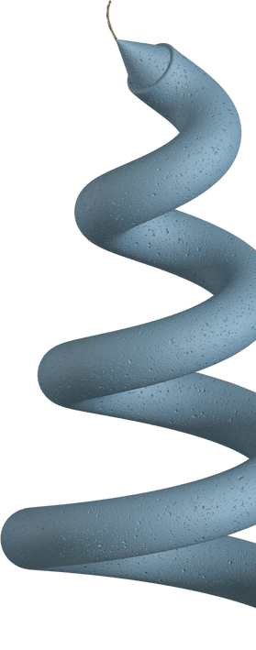

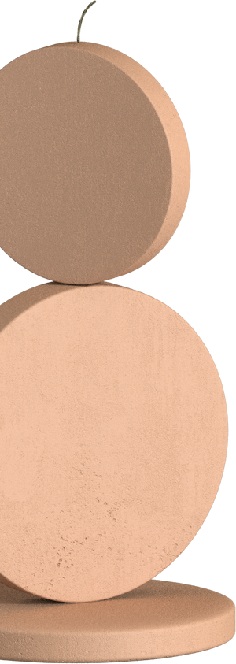
Overview
The most well-known method for maintaining data security is cryptography.
A new area of encryption called DNA cryptography is developing
DNA cryptography, in contrast to conventional cryptography, secures data by combining cryptographic methods with DNA properties.
Steganography conceals the existence of any data. The goal of steganography is to provide sealed information.
Henceforth, it is hard for the third person or attackers to know about the presence of the masked message in the cover media like image, audio, video, etc.

Slide 4
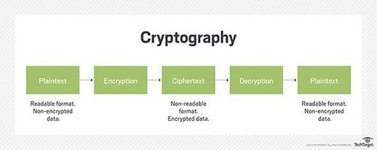
Basic Idea of Cryptography
https://www.techtarget.com/searchsecurity/definition/cryptography

Slide 5
Basic components of a cryptosystem
Plain Text Cipher Text
Encryption Algorithm Decryption Algortihm Encryption Key Decryption Key

Slide 6
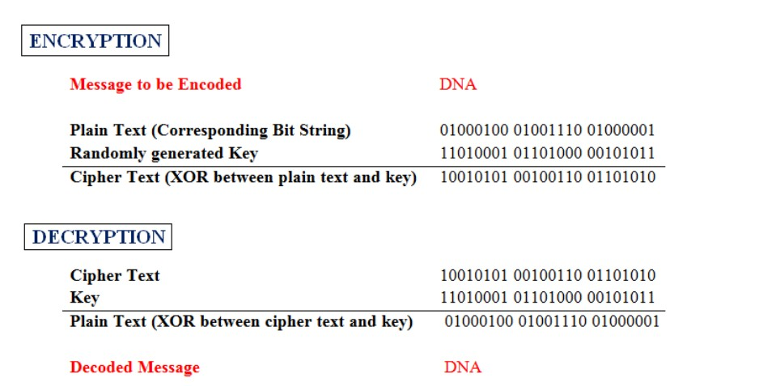
One Time Pad

Slide 7
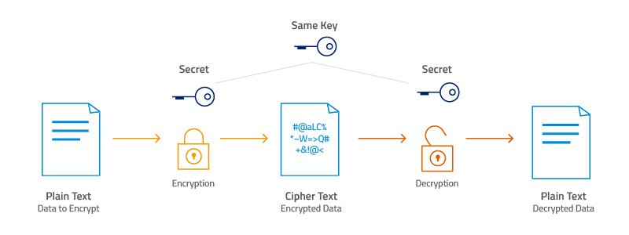
AES - 256 Encryption and Decryption
https://www.atpinc.com/blog/what-is-aes-256-encryption

Slide 8
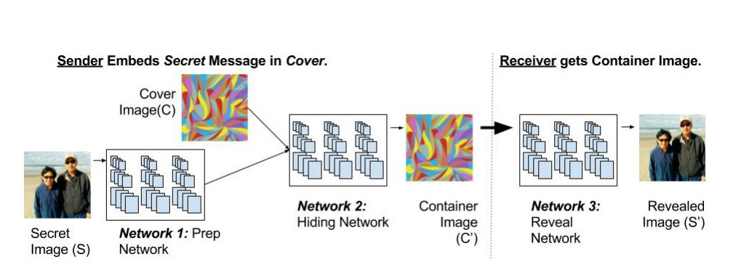
Hiding Images in Plain Sight: Deep Steganography
Access the paper here
The paper focuses on explaining the basics of steganography. We will be learning what steganography is from this paper and will try to implement it.

Slide 9
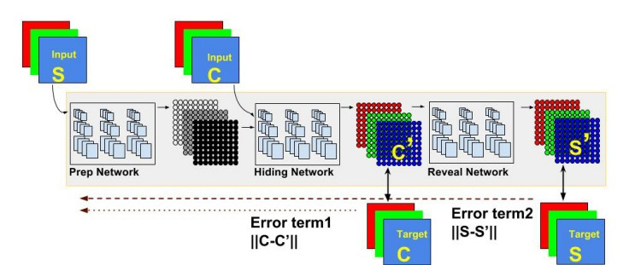
Takeaways from the paper and questions answered in the paper
Architectures and Error Propagation
What if the original cover image became accessible?
Where is the Secret Image Encoded?

Slide 10
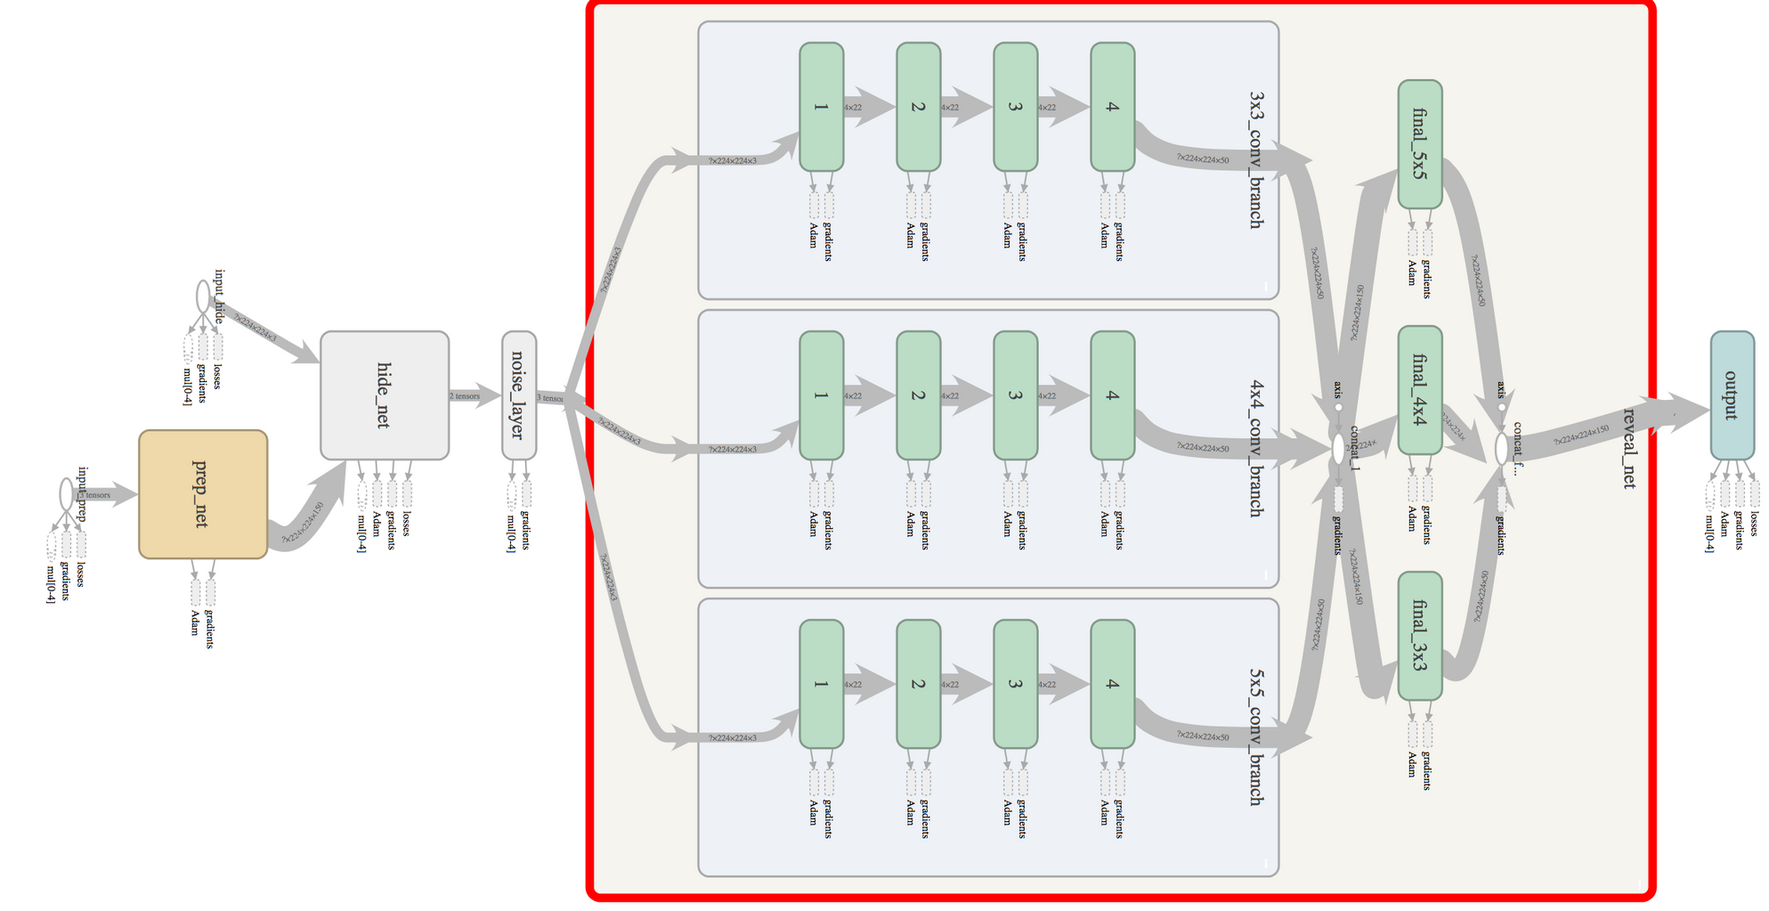
Architecture

Slide 11
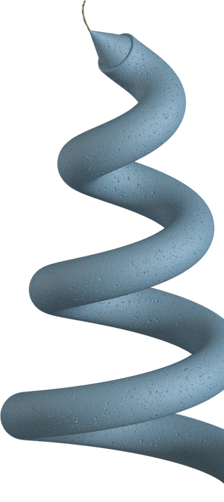
De Brujin and Greedy Path search Algorithm
Here we have considered a de novo strand assembly which is developed using DBGPS algorithm and it shows major improvements in strands handling, rearangements and indels.The most developed factors are a result of accelerated aging, multiple independent data retrievals, deep error-prone PCR and large scale data simulations. Part of the sample testing included retrieving a
6.8 MB of data from a severely corrupted sample which was kept at 70 °C for 70 days. This algorithm give a logical density of 1.3 bits/cycle and storing 295 Pb of
data per gram.

Slide 12
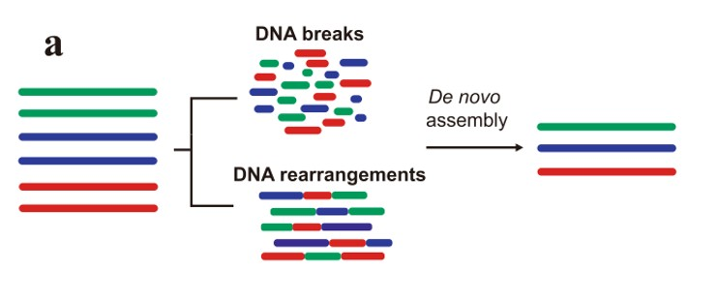
Formation of de novo assembly strands

Slide 13
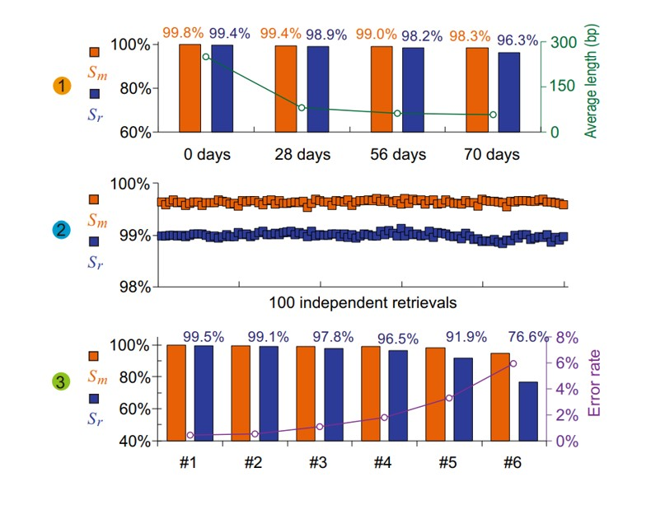
Results of DBGPS algorithm

Slide 14
DNA
Steganography
Protecting data is crucial
Through this project, we are not implementing the idea of a single individual paper. Rather, we are trying to pick the best ideas from each paper and are trying to build a robust DNA steganograpy system, which cannot be detected by outer system and also is able to handle any kind of errors.

Slide 15

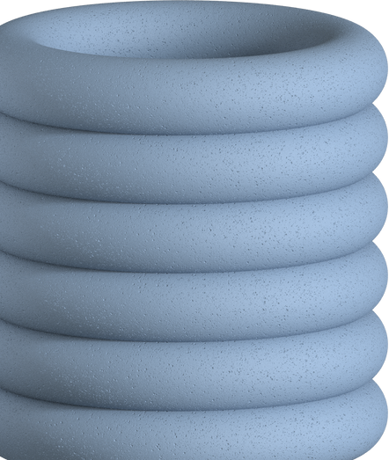
Encryption Key
Image
Secret Message
Encrypted Message
Encrypted Image
AES
Steganography
2-D DNA
Original Secret Message
Decrypted Message
Decrypted Image
Decryption Key

Slide 16
Implementation
CRYPTOGRAPHY
Using method AES or one time pad system.
STEGANOGRAPY
Using image steganography.
IMAGE STORAGE IN DNA

Slide 17
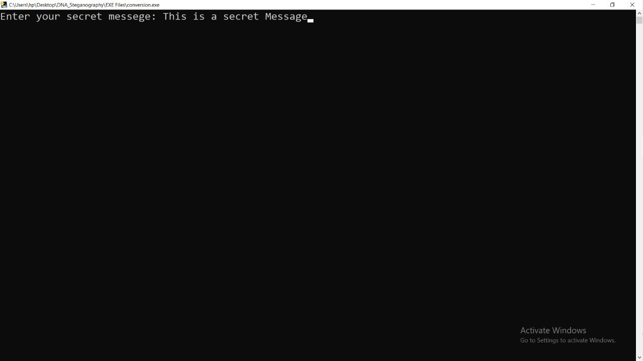
OUTPUT

Slide 18
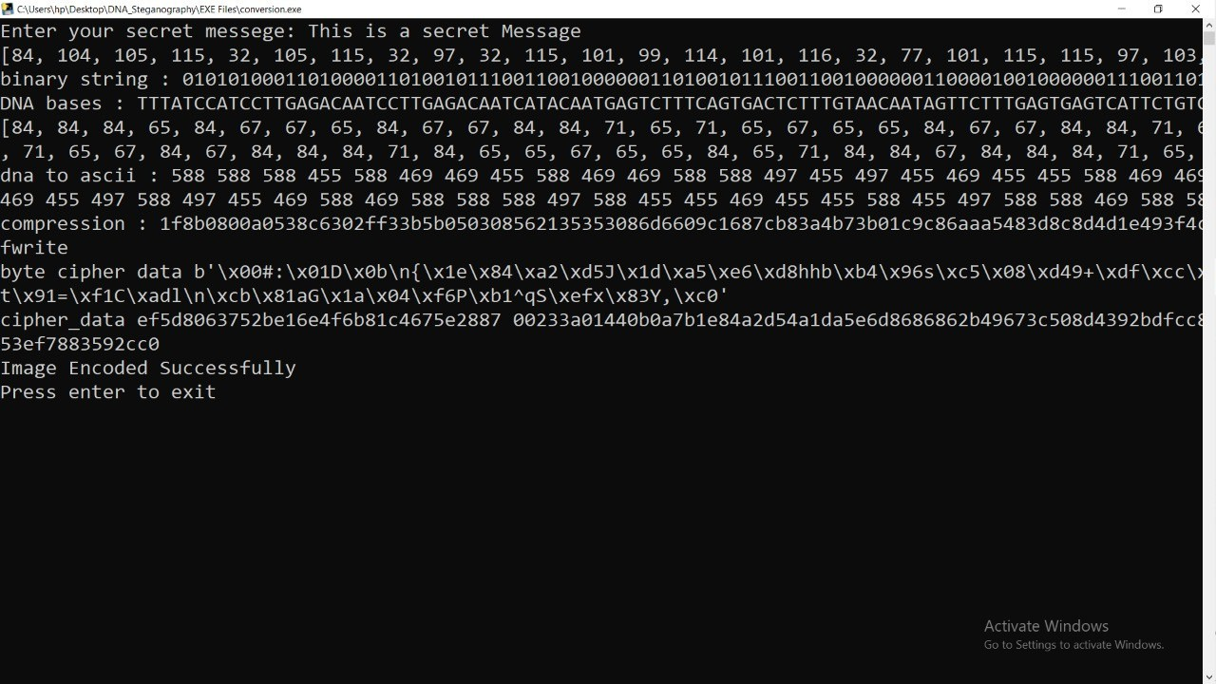

Slide 19
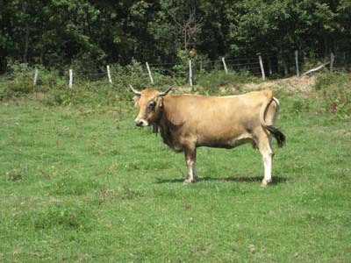
Steganographic image used to hide the secret messasge
There is possibility of changes in the pixel of an image which is not visible to the naked eye. Hence, this method serves as a very strong method to send data across.

Slide 20
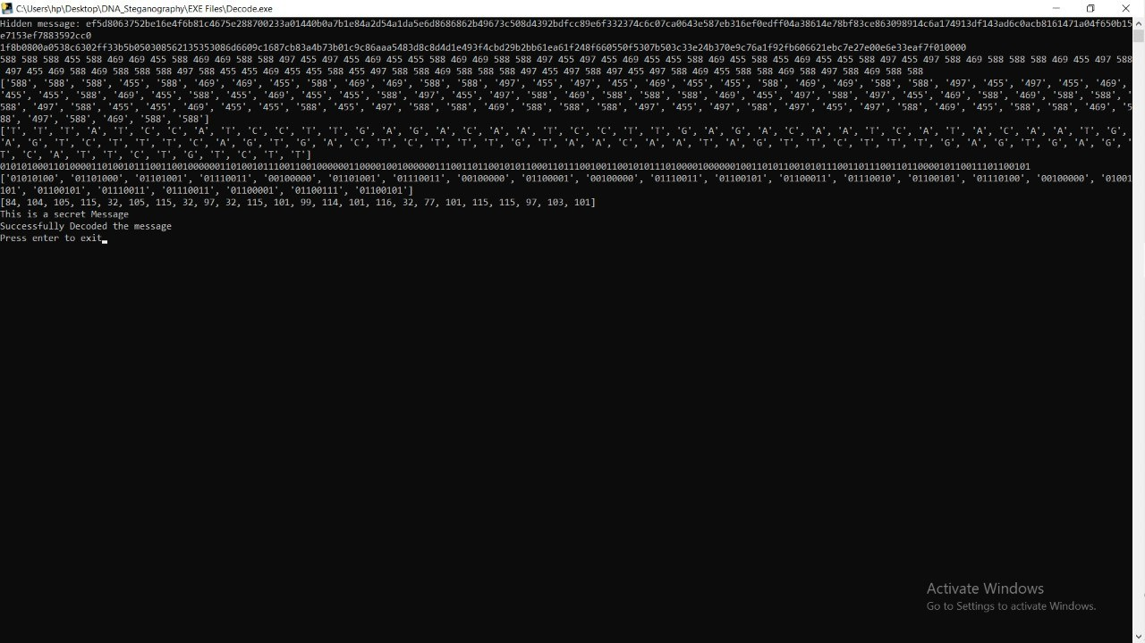

Slide 21
Major challenges of DNA data storage
01
02
03
Strand Breaks
Rearrangements
Indels that arise during DNA synthesis , amplification etc.

Slide 22

References
http://www.esprockets.com/papers/nips2017.pdf https://www.nature.com/articles/s41467-022-33046-w https://www.nature.com/articles/s41467-021-27846-9 https://www.nature.com/articles/s41467-018-07144-7#Sec6

